Slide 1
Chapter 2: The System-on-Chip Design Process
Reuse Methodology Manual for System-On-Chip Designs
Notes:
This is the light cover slide option.

Slide 2
Chapter content
A Canonical SoC Design
System Design Flow
The role of specifications throughout the life of a project
Steps for system design process

Slide 3
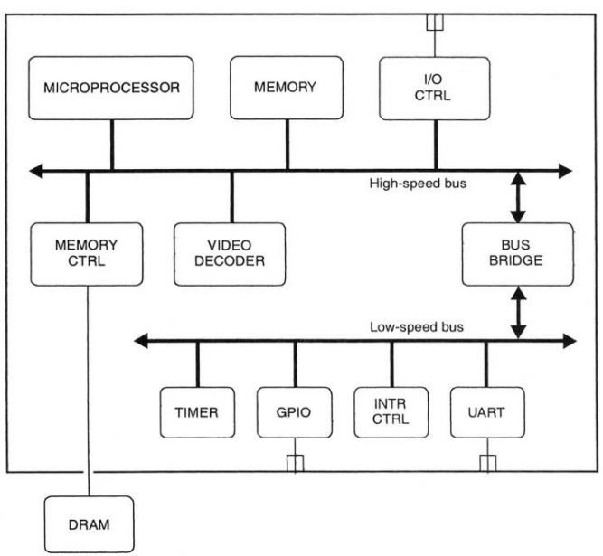
1. A Canonical SoC Design
The following design represents a generic (canonical) form of an SoC that it consists of:
A microprocessor and its memory subsystem
On-chip buses (high-speed and low-speed) to provide the datapath between cores
A memory controller for external memory
A communications controller
A video decoder
A timer and interrupt controller
A general purpose I/O (GPIO) interface
A UART interface
The main idea here is that normally the chip consists of multiple blocks that are designed and verified first before being assembled to the chip.
Thus, the canonical design is just a miniature version of an SoC design that allows us to discuss the challenges of developing these chips utilizing reusable macros.

Slide 4
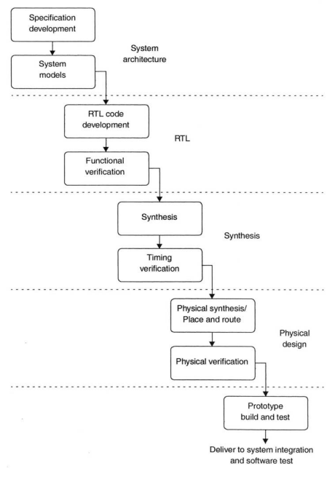
2. System Design Flow
To meet the challenges of SoC, chip designers are changing their design flows in two major ways:
From a “waterfall model” to a “spiral model”
From a “top-down” methodology to a combination of “top-down and bottom-up”
2.1 Waterfall vs. Spiral
In a waterfall model, the project transitions from phase to phase in a step function, never returning to the activities of the previous phase. In this model, the design is often tossed “over the wall” from one team to the next without much interaction between the teams.
The obvious problem here is the “handoffs” where typically in any system, it’s rarely each stage will give clean results, rather it’s always needed to get back to the previous stages to fix some issues.
For large, deep submicron designs, this waterfall methodology simply does not work. Physical design issues must be considered early in the design process to ensure that the design can meet its performance goals.

Slide 5
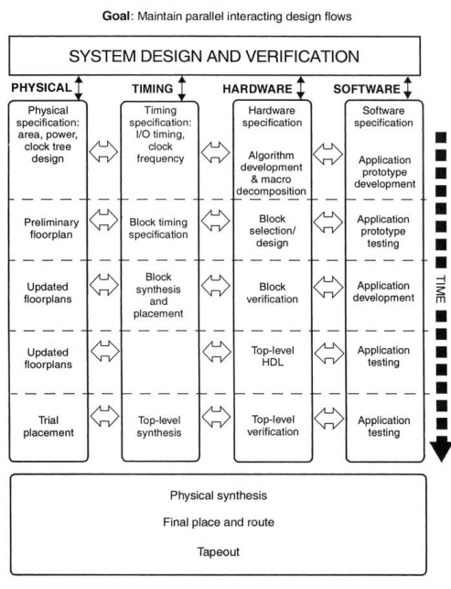
2. System Design Flow
2.1 Waterfall vs. Spiral
For the problems discussed, in addition to the increasing of the design complexity, many teams are moving to the newer spiral development model.
In the spiral model, the design team works on multiple aspects of the design simultaneously, incrementally improving in each area as the design converges on completion. Where the flow is characterized by:
Parallel, concurrent development of hardware and software
Parallel verification and synthesis of modules
Floorplanning and place-and-route included in the synthesis process
Modules developed only if a pre-designed hard or soft macro is not available
Planned iteration throughout

Slide 6
2. System Design Flow
2.2 Top-Down vs. Bottom-Up
The classic top-down design process can be viewed as a recursive routine that begins with specification and decomposition, and ends with integration and verification:
Write complete specifications for the system or subsystem being designed.
Refine its architecture and algorithms, including software design and hardware/software cosimulation if necessary.
Decompose the architecture into well-defined macros.
Design or select macros; this is where the recursion occurs.
Integrate macros into the top level; verify functionality and timing.
Deliver the subsystem/system to the next higher level of integration; at the top level, this is tapeout.
Verify all aspects of the design (functionality, timing, etc.).
like the waterfall model, the top-down design methodology is an idealization of what can really be achieved. A top-down methodology assumes that the lowest level blocks specified can, in fact, be designed and built. If it turns out that a block is not feasible to design, the whole specification process has to be repeated.
For this reason, real world design teams usually use a mixture of top-down and bottom-up methodologies, building critical low-level blocks while they refine the system and block specifications
Libraries of reusable hard and soft macros clearly facilitate this process by providing a source of pre-verified blocks, proving that at least some parts of the design can be designed and fabricated in the target technology and perform to specification.

Slide 7
2. System Design Flow
2.3 Construct By Correction
The Sun Microsystems engineers that developed the UltraSPARC processor have described their design process as “construct by correction”.
In this project, a single team took the design from architectural definition through place and route. In this case, the engineers had to learn how to use the place and route tools, whereas, in the past, they had always relied on a separate team for physical design.
By going through the entire flow, the team was able to see for themselves the impact that their architectural decisions had on the area, power, and performance of the final design. Also, they were able to see their mistakes, correct them and refine the design several times before the design was finally released to fabrication.
The UltraSPARC team made the first pass through the design cycle—from architecture to layout—as fast as possible, allowing for multiple iterations through the entire process.
This process is the opposite of “correct by construction” where the intent is to get the design completely right during the first pass. As discussed above, it was not possible at the architectural phase of the design to foresee all the implication their decision would have on the final physical design.

Slide 8
2. System Design Flow
2.4 Summary
It has been found that iteration in the development process is inevitable. So, it would be a significant value in planning for iteration to minimize the overall design time (number of major iterations). As going back to the specification after an initial layout of a chip is expensive.
We would prefer to iterate in tight, local loops, such as coding, verifying, and synthesizing small blocks. These loops can be very fast and productive.
Spending time in carefully specifying a design is the best way to minimize the number of iterative loops and to minimize the amount of time spent in each loop.

Slide 9
3. The Specification Problem
The first part of the design process consists of recursively developing, verifying, and refining a set of specifications until they are detailed enough to allow RTL coding to begin.
In a successful design methodology, it is the most crucial, challenging, and lengthy phase of the project. If you know what you want to build, implementation mistakes are quickly spotted and fixed. If you don’t know, you may not spot major errors until late in the design cycle or until fabrication.
Similarly, the cost of documenting a specification during the early phases of a design is much less than the cost of documenting it after the design is completed. Where documenting after the completion adds no value for the designer and either delays the project or is skipped altogether.

Slide 10
3. The Specification Problem
3.1 Specification Requirements
Specifications describe the behavior of a system; more specifically, they describe how to manipulate the interfaces of a system to produce the desired behavior.
Functional specifications describe the interfaces of a system or block as seen by the user of the systems. They describe the pins, buses, and registers, and how these can be used to manipulate data.
Architectural specifications describe the interfaces between component parts and how transactions on these interfaces coordinate the functions of each block, and create the desired system-level behavior.
In an SoC design, specifications are required for both the hardware and software portions of the design. The specifications must completely describe all the interfaces between the design and its environment, including:
Hardware: | Software:
Functionality External interfaces to other hardware (pins, buses, and how to use them) Interface to SW (register definitions) Timing Performance Physical design issues such as area and power | Functionality Timing Performance Interface to HW SW structure, kernel

Slide 11
3. The Specification Problem
3.2 Types of Specifications
Traditionally, specifications have been written in a natural language, such as English, and have been plagued by ambiguities, incompleteness, and errors. Many companies, realizing the problems this causes, have started using executable specifications for some or all of the system.
Formal Specifications the desired characteristics of the design are defined independently of any implementation.
Once a formal specification is generated for a design, formal methods such as property checking can be used to prove that a specific implementation meets the requirements of the specification.
A number of formal specification languages have been developed, including one for VHDL called VSPEC.
These languages typically provide a mechanism for describing not only functional behavior, but timing, power, and area requirements as well.
Executable specifications more useful for describing functional behavior in most design situations.
An executable specification is typically an abstract model for the hardware and/or software being specified.
For high-level specifications, it is typically written in C, C++. For lower levels, hardware is usually described in Verilog or VHDL.
Developing these models early in the design process allows the design team to verify the basic functionality and interfaces of the hardware and software long before the detailed design begins.
Most executable specifications address only the functional behavior of a system, so it may still be necessary to describe critical physical specifications—timing, clock frequency, area, and power requirements—in a written document.

Slide 12
4. The System Design Process
Determining the optimal architecture in terms of cost and performance involves a large number of complex decisions and tradeoffs, such as:
What goes in software and what goes in hardware?
What processor(s) to use, and how many?
What bus architecture is required to achieve the required system performance?
What memory architecture to use to reach an appropriate balance between power, area, and speed?
In most SoC designs, it is not possible, purely by analysis, to develop a system architecture that meets the design team’s cost and performance objectives. Thus, the system design process consists of proposing a candidate system design and then developing a series of models to evaluate and refine the design.

Slide 13
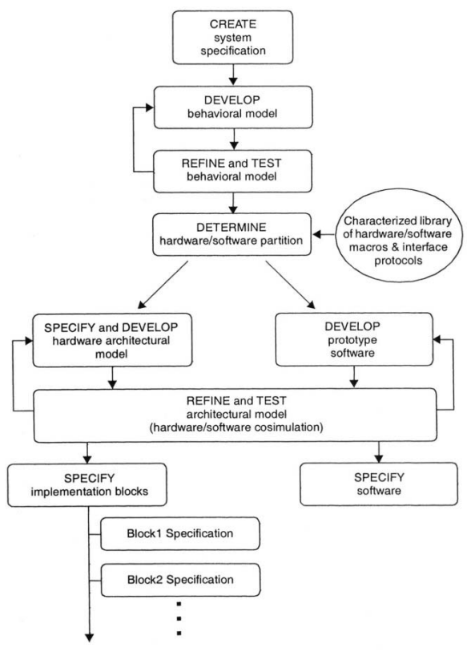
4. The System Design Process
The system design process shown employs both executable and written specifications to specify and refine a system architecture. This process involves the following steps:
1. Create the System Specifications:
Identifying the objectives of the design; that is, the system requirements: the required functions, performance, cost, and development time for the system.
These are formulated into a preliminary specification, often written jointly by engineering and marketing.
2. Develop a Behavioral Model
The next step is to develop an initial high-level design and create a high-level behavioral model for the overall system.
This model can be used to test the basic algorithms of the system design and to show that they meet the requirements outlined in the specification.
This high-level model provides an executable specification for the key functions of the system. It can then be used as the reference for future versions of the design.

Slide 14
4. The System Design Process
3. Refine and Test the Behavioral Model:
A verification environment for the high-level model is developed to refine and test the algorithm.
These are formulated into a preliminary specification, often written jointly by engineering and marketing.
If properly designed, it can also be used later to verify models for the hardware and software, such as an RTL model verified using hardware/software cosimulation.
Forsystems with very high algorithmic content, considerable model development, testing, and refinement occurs before the hardware/software partitioning.
For instance, a graphics or multimedia system may be initially coded in C/C++ with all floating-point operations. This approach allows the system architect to code and debug the basic algorithm quickly. Once the algorithm is determined, a fixed-point version of the model is developed. This allows the architect to determine what accuracy is required in each operation to achieve performance goals while minimizing die area. (was discussed in a previous meeting with Dr. Ahmed Hesham)

Slide 15
4. The System Design Process
4. Determine the hardware/software partition (decomposition):
As the high-level model is refined, the system architects determine the hardware/software partition; that is, the division of system functionality between hardware and software. This requires judgement by experience and good understanding of the different tradeoffs.
The final step in hardware/software partitioning is to define the interfaces between hardware and software, and specify the communication protocols between them.
5. Specify and develop a hardware architectural model
Once the requirements for the hardware are defined, it is necessary to specify a detailed hardware architecture. This involves determining which hardware blocks will be used and how they will communicate.
Memory architecture, bus structure and bus bandwidth can be critical issues. Most SoC chips have many different blocks communicating over one or more buses. The traffic over these buses and thus the required bandwidth can be very application dependent, so it becomes necessary to evaluate architectures by running substantial amounts of representative application code on them.
Running significant amounts of application code on an RTL-level design is often too time consuming to be practical. To address this problem, designers are using transaction-level models to model interfaces and bus behavior. By eliminating the detailed behavior of pins and signals on a bus or interface, these models can run considerably faster than RTL models, yet still give accurate estimates of performance.
Determining the final hardware architecture consists of developing, testing, and modifying architectural-level models of the system until an architecture is demonstrated to meet the system requirements.

Slide 16
4. The System Design Process
6. Refine and Test the architectural Model:
One of the classic problems in system design is that software development often starts only once the hardware has been built. This serialization of hardware and software development has led to many delayed or even cancelled projects.
The architectural model for the system can be used for hardware/software cosimulation. It provides sufficient accuracy that software can be developed and debugged on it, long in advance of getting actual hardware.
Having fast, accurate models of the hardware will be key to this aspect of SoC design.
7. Specify Implementation blocks
The output of the architectural exploration activity is a hardware specification: a detailed specification of the functionality, performance, and interfaces for the hardware system and its component blocks.
In its written form, the hardware specification includes a description of the basic functions, the timing, area, and power requirements, and the physical and software interfaces, with detailed descriptions of the I/O pins and the register map.
The architectural model itself functions as an executable specification for the hardware.

